Slide 1

SIT105 – Thinking Technology and Design Class 02
Claims and Issues
Dr. Frank Jiang
Frank.Jiang@deakin.edu.au

Slide 2
Review of last week – Problem Solving Skills

Slide 3
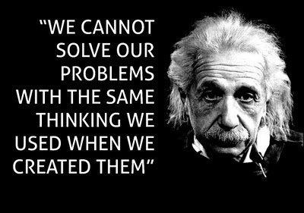
Critical Thinking Quote of the Week
Albert Einstein
Theoretical Physicist
Often as humans we fall into certain patterns to solve problems.
We need to recognize the problem and realise that you have to change the process to get a different result.

Slide 4
So let’s look at critical thinking: claims and issues!
This week’s ULO – [1] Apply critical thinking techniques and IT discourse to identify and analyse problems from technical and non-technical perspectives.

Slide 5
Last Week… Problem Solving
Knowing where to start solving a problem requires critical thinking to analyse and understand a problem.
A problem often contains:
Irrelevant information
Smaller problems
Valid and invalid claims or arguments
Knowing when to question a claim by making an issue
Agenda from others

Slide 6

Critical Thinking?
It is an analytical stance on assessing claims, you have read, heard or saw.
It will be the process that allows you to go through to determine whether you agree or disagree
One popular definition of critical thinking is:
“The careful application of reason in the determination of whether a claim is true” –Moore and Parker
What do you need to think critically?
Precise, careful and intentional thinking
It takes time to do this, as you often need to do thorough research.
Ensure you are using reason or logic.
Application to real world problems (like we cover in this class)
Focus on the issue at hand and all its complexities

Slide 7
Why do we need Critical Thinking…
The aim of critical thinking comes down to ensuring that we have good reasons for our beliefs.
Evaluate completely ALL parts of a claim someone has made… every part as well as a whole.
Some critical thinking skills involve recognition, analysis and evaluation…
These skills can be useful for participating in discussions about controversial issues such as the ones we will look at in class, but also with your study in other units.
Additionally, it will help you to be more successful in your career!
By avoiding being manipulated by people who want your money or support, and generally live a deeper more meaningful life.

Slide 8

Critical Thinking in Use
Critical thinking will be useful in your studies, and when you graduate and work in the IT industry, because you will need to:
Assess claims made by the news, project clients, co-workers and your classmates.
You will often have to critically evaluate claims made by others.
Other times you will defend your own claims.
So you will need to think critically about your own perspectives.

Slide 9
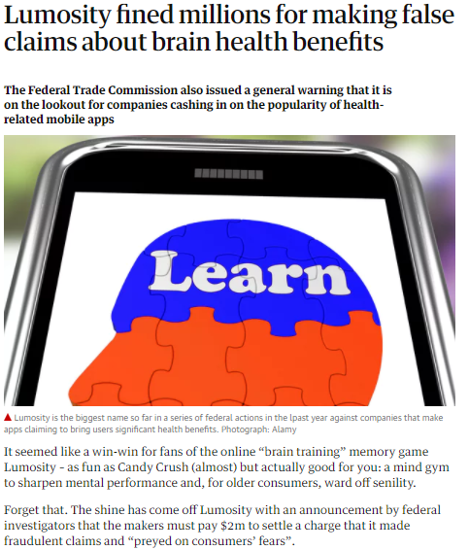
When False Technology Claims Cause Problems
Let’s read the main parts of this article as a class!
https://www.theguardian.com/technology/2016/jan/06/lumosity-fined-false-claims-brain-training-online-games-mental-health
Let’s discuss this topic as a class:
What were the main claims Luminosity were making, that were deemed false?
Why were they particularly dangerous in this instance?

Slide 10
Critical Thinking, Mechanics?
In our context Critical Thinking is:
assessing whether a claim is true (or false) by carefully applying reason.
Critical thinking occurs when we:
consider arguments,
develop arguments, and
reason.
Reason to decide what to do and what to believe

Slide 11

More on Critical Thinking
This week !
Critical thinking occurs when we can:
identify claims,
develop issues and
develop arguments.
These actions will help you:
remove irrelevant information
focus on and assess the real problem
understand the real problem

Slide 12

Claims and Issues
Most arguments start with a claim or an issue.
For example, when your arguing whether iPhones CPU is better than Galaxy's CPU or whether the iPhone is more secure than Galaxy phones.
These are 2 separate issues but will end up in the same debate around what you might call ‘quality’.
People will try to mash these two issues together, and this is when problems occur!
If issues get mashed together your thinking will get confused, they will do this to try and confuse you or manipulate you.
What I hope for you is to be able to identify a claim and what issue that claim is connected to.
Distinguish different issues, to cut through the crap!

Slide 13

Let’s Start on Claims
Let’s take a look into claims or what they can also be referred to as, statements.
Basically, claims are the kind of sentences that are either true or false (or in IT: binary - 1 or 0)
A claim is a statement, that declares that something is or is not the case.
A statement is going to be true if what it declares is the case, and it is false if what it asserts is not the case.

Slide 14
So….Claims?
A claim is simply a statement which can be true or false.
The following are claims:
Australia is the driest continent on Earth.
Some penguins live in Australia.
The Sony PS4 is the most powerful gaming console.
True
Claim
False

Slide 15
Not a Claim? Examples
A claim is a sentence where the main purpose is to communicate something that is either true or false.
Questions, commands and advice are not claims!
Go home !
How did you do that ?
I promise to return the book to the library.
Thank you for your help.
Something can be a claim even if we don’t know whether it’s true or false!
Example: The telephone in Dr. Nick’s office is blue.
This is false (it's not blue) but it's still a claim.

Slide 16

Any Tips for Determining a Claim?
I want to give you one way that helps me to determine whether or not a sentence expresses a claim.
Just remember that claims are the kind of things that can be true or false, not that we know whether they are actually true or false.
One trick is that you can essentially use the phrase: ‘it is true that’ before the sentence.
The ones that make sense are claims; the ones that don’t, are not claims.

Slide 17
Okay so now we know what claims are, but what are issues?

Slide 18
Issues
Question?
True
Claim
False
An issue is a question regarding whether a claim is true or false.
The issue is what is up for debate or what is being questioned!
Producing issues is important.
Why? So that we can participate in critical thinking and have good reasons for our beliefs or what we hold as accurate knowledge.
With this we can:
Conduct reasoning
Ask questions

Slide 19
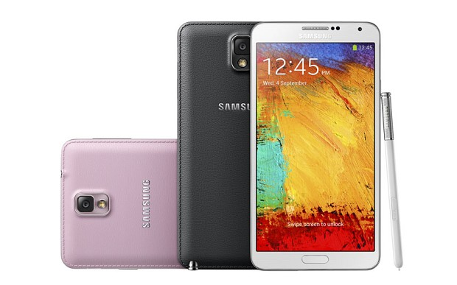

Issues
Consider these two claims:
Mobile phones are recent devices.
A student does not need a mobile phone.
First do you agree or disagree with both?
When you make a question about the truth of a claim, you are making an issue!

Slide 20

Issues (Examples)
Claim – Mobile phones are recent devices.
Issue – Are mobile phones recent devices?
Claim – A student does not need a mobile phone.
Issue – Does a student need a mobile phone?
Claim – The Sony PS4 is the most powerful gaming console
Issue – Is the Sony PS4 the most powerful gaming console?

Slide 21
Now let’s look at the theme of this week.
The social problem revolving around
The WikiLeaks CIA issue!

Slide 22
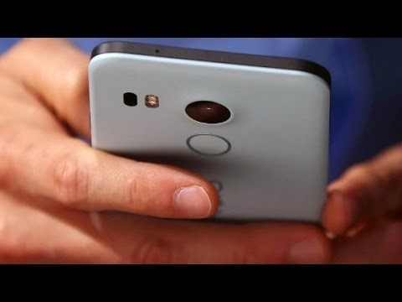
[Video] WikiLeaks: CIA hacks phones, TVs worldwide
Source: videos\WikiLeaks_ CIA hacks phones, TVs worldwide.mkv

Slide 23

News: How the CIA hacking tools allegedly work: inside the WikiLeaks files
WikiLeaks has claimed the CIA can pretty much hack into any device with its range of hacking tools, designed to read and lift data from electronic devices.
The first batch to be leaked, dubbed 'Year Zero' is comprised of 8,761 documents and files that reportedly detail how authorities have discovered a way to break through the encryption in highly secure messaging platforms such as WhatsApp, Telegram and Signal.
This is done by accessing the data on devices before encryption is applied on Android and using other methods on the iPhone, Microsoft Windows and even Samsung smart TVs.
WikiLeaks explained that the agency "lost control" of its hacking weapons, including malware, viruses, trojans, weaponised "zero day" exploits, malware remote control systems and associated documentation.
Source: https://www.bit.com.au/News/453997,how-the-cia-hacking-tools-allegedly-work-inside-the-wikileaks-files.aspx.

Slide 24

CIA Spying: News Article Discussion
Make a small group with the students next to you (2-3).
Spend 5 minutes discussing the following questions.
Do you think the CIA/Government should be authorised to view everything we send/receive via technology or listen in on our conversations?
Should WikiLeaks keep these tools private or release them to the public?
Task: Keep note of any claims or issues mentioned for the next activity.
Load up the article from the last slide

Slide 25

CIA Spying: News Article Discussion: Let’s spend a minute!
Did you pick up on any claims in the article, in your discussion or did you raise any questions on those claims?
Let’s try fill this table!
Claims | Issues

Slide 26
Following the Video Select the Best Response!
Which one of the three responses below is a claim?
The CIA has the ability to hack ‘Smart’ Televisions
Was Wikileaks involved in stealing these documents from the CIA?
These documented CIA cyber-attacks are bad because they are designed to spy on people around the world
Yes #1 is structurally a claim.
…Though is it really true or false? What is the proof?

Slide 27


Take 5
From today’s class and our group discussions.
Take 2-3 minutes to jot down the main things you learned today…. What are your ‘takeaways’.

Slide 28
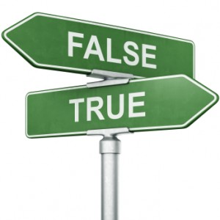
In Conclusion…
Claims are either true or false.
Remember it is about the structure, not necessarily is it true or false. Can it be true or false.
Issue: a matter of controversy or uncertainty – a question about a claim! (we are suspicious and need to raise an issue).
Critical Thinking: The careful, deliberate determination of whether to accept, reject, or suspend judgment about a claim – and the degree of confidence with which we accept or reject it.
Spying technology – can be a benefit and a problem (if its lost into the wrong hands)!
WikiLeaks has claimed the CIA can pretty much hack into any device. Is it true or false?

Slide 29

End of Class!
Any Questions?
Readings:
Extract 1 and 2.
Critical Thinking and Problem Solving for IT,
This article: WikiLeaks CIA hack: What you need to know about the Vault 7 data dump
http://www.abc.net.au/news/2017-03-08/what-you-need-to-know-about-cia-wikileaks-vault7-hack/8335072

Slide 30
Extra Content & Activities!

Slide 31
CIA Hacks: Mock Case Study
Wikileaks releases all these powerful hacking tools to the public over the internet.
The US Government due to public pressure decides to penalise the CIA for using these tools without permission.
The CIA is prevented from using the tools legally now and in the future.
The enemies of the USA obtain these tools from Wikileaks and use them to spy and attack the devices of its Government and citizens.
Many of the USA’s secrets as well as its citizens privacy is no longer secure.
Spend 2-3 minutes analysing and dissecting this case in detail by yourself. What are the main issues?
As next you will discuss with the student next to you! （Please find a way of discussions, either online or else ☺）

Slide 32
CIA Hacks: Mock Case Study
Consider these questions with the student next to you and share ideas and/or contrasting opinions (5 min) (Pending).
We will re-group as a whole class and gather responses from some or all of the pairs (5 min) (Pending).
What are the true/false (claims) about this situation you can find?
What questions (issues) can you raise about these claims ?
What is the underlying problem which can result from anyone being able to have access to these massively powerful tools?
If this were to happen, how could you maybe be better equipped to avoid becoming a victim?

